Slide 1

Vacci-Nation
Modelling the outbreak of an influenza strain in a population with different belief groups

Slide 2
Motivation
Medicine and vaccines form a foundation of modern societies
“Anti-vaccination“ groups are on the rise
Cases of formerly extinct diseases are appearing again
Flu / Influenza especially interesting
Mutation every year
Almost yearly outbreaks
→ Vaccination behaviour as an interesting game theoretical problem

Slide 3

Literature Review

Slide 4
Modeling infectious diseases
Compartmental models are commonly used in disease modelling (SIR, SEI, SIS, SIRS, etc.)
Kermack and McKendrick (1927)
Adaptations for different subpopulations and disease processes (Dadlani, 2013)
Mass-action assumption – homogeneous, fully connected populations -> Networks (Keeling and Eames, 2005)
Network structure is decisive for the spread of a disease (Pastor-Satorras and Vespignani, 2002; Liu et al., 2015; etc.)

Slide 5
Game Theoretical Analyses
Insufficient uptake levels, given selfish agents and even minimal costs of vaccination (Bauch and Earn, 2004)
Game theory and network model (Shi et al., 2017):
Heterogeneous network structures can preserve vaccination rates if relative costs are increasing
Highly connected agents more likely to vaccinate if only neighbours are considered
Strong effects of belief-groups on uptakes and spreading
Committed vaccinators increase uptakes and avoid clustering (Liu et al., 2012)
Fraction of sceptics drives reduced uptake rates rather than discrepancy in cost assessments (Shim et al., 2012; Stegehuis et al. 2016)

Slide 6
Our Model

Slide 7
General Assumptions
SIVR-model with a constant population and two belief groups (trusters vs. sceptical)
Agents are almost rational utility-maximisers and rely on local prevalence of the disease for their assessments
Time-horizon of an agent is bounded (only a few time steps are considered in decisions)
The population is modelled using a small-world graph based on the Watts-Strogatz model

Slide 8
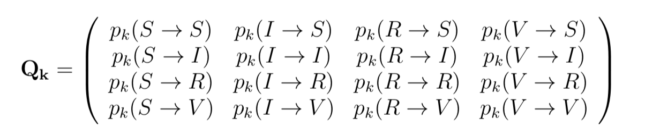
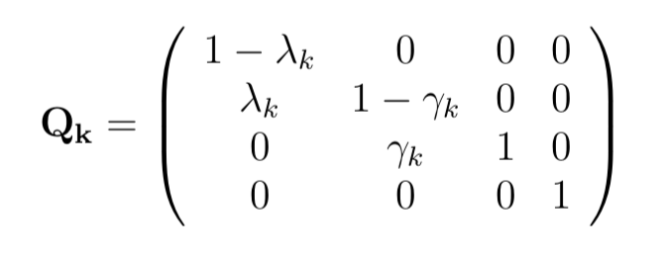
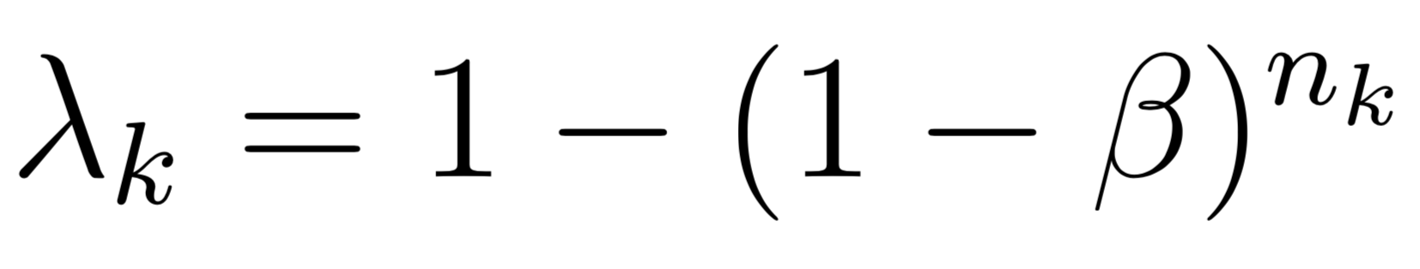
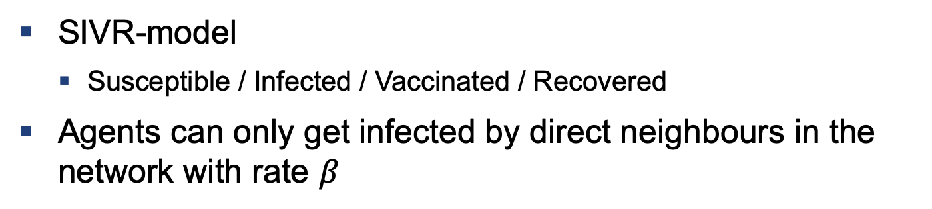
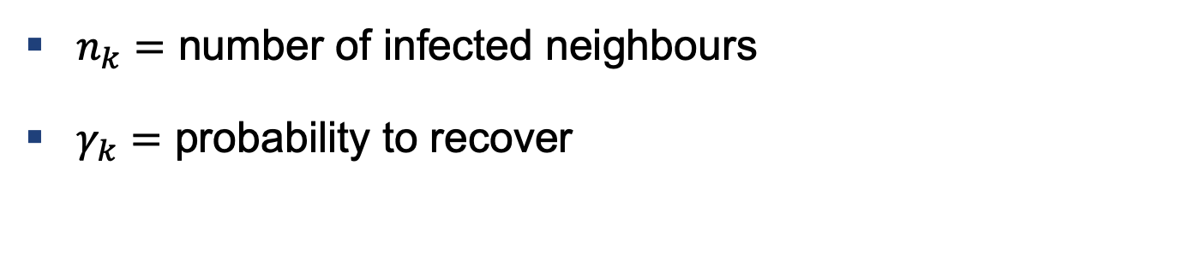
Epidemiology
SIVR-model
Susceptible / Infected / Vaccinated / Recovered
Agents can only get infected by direct neighbours in the network with rate $β$
$n_{k}=$ number of infected neighbours
$γ_{k}=$ probability to recover

Slide 9
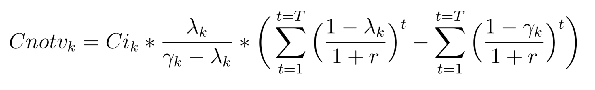
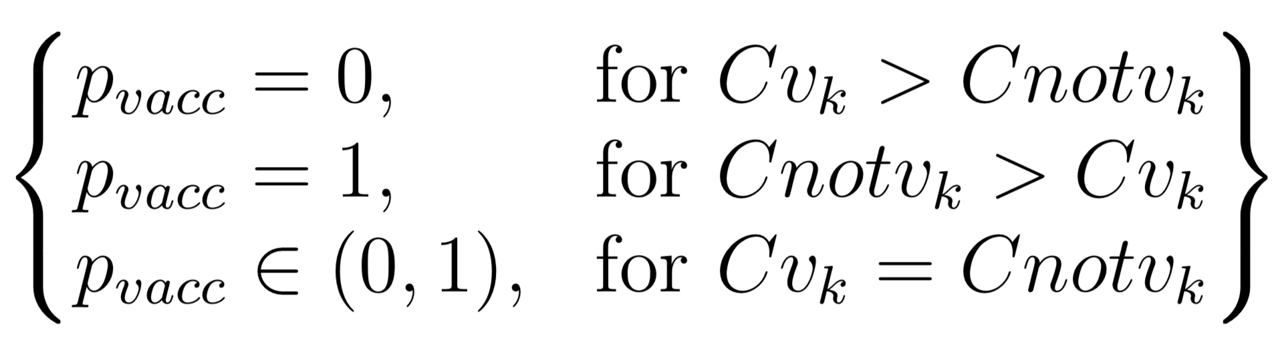
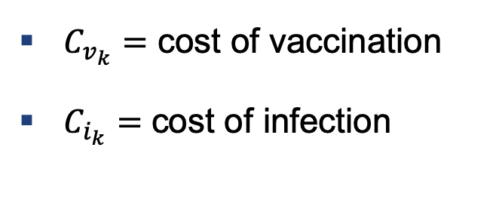
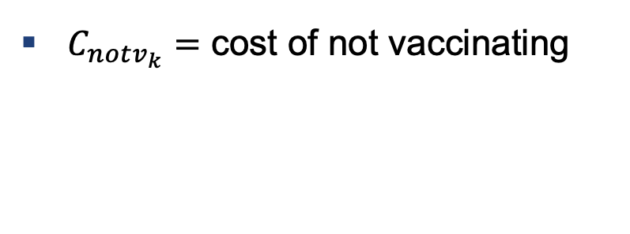
Epidemiology
With this data the agent derives its utility function
The decision to vaccinate or not can be expressed as
$C_{v_{k}}=$ cost of vaccination
$C_{i_{k}}=$ cost of infection
$C_{notv_{k}}=$ cost of not vaccinating

Slide 10
Implementation
Simulation carried out using Python
Specifically numpy, networkx and matplotlib
main.py to loop over network for each timestep
SmallWorld class to create the network
Agent class containing utility function and maximization problem

Slide 11
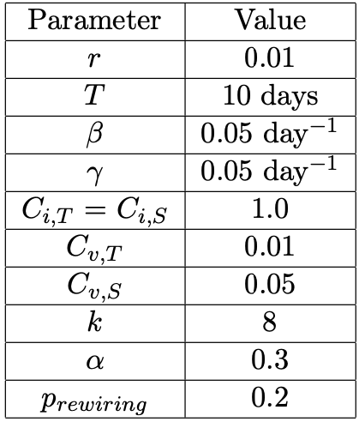
Initial Setup

Slide 12
Results and Outlook

Slide 13
Main Results
Agents are cost-sensitive regarding the uptakes of vaccines
Increasing the share of trusters in the community yields an even higher ratio of vaccinated trusters to vaccinated skepticals
The spread of the disease is significantly influenced by the time which the agents need to update their decisions
Uptake levels are more sensitive to the share of trusters in the community, compared to the cost-ratios of the individual communities
Protection in truster community: In the truster community, agents are more likely to stay healthy throughout the outbreak, even if they do not vaccinate
r@Liz0MHW0

Slide 14
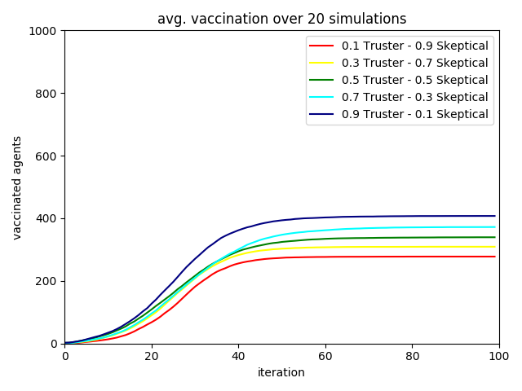
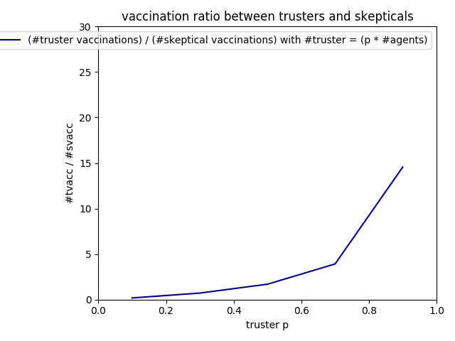
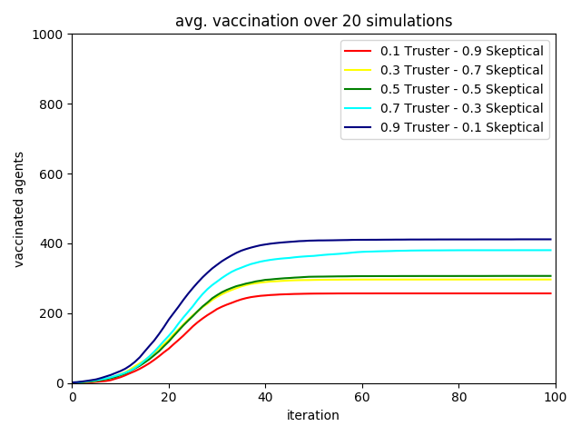
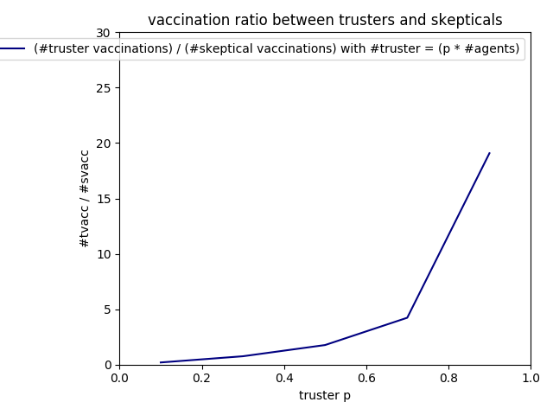
Main Results – alpha = {0.05, 0.3}

Slide 15
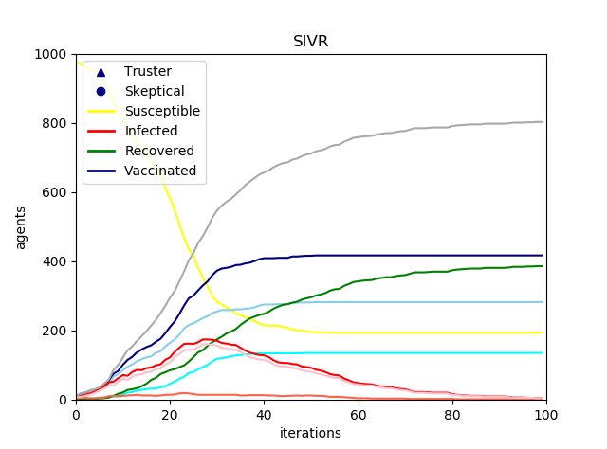
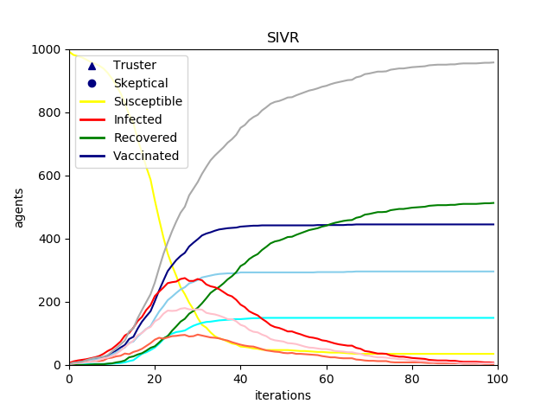
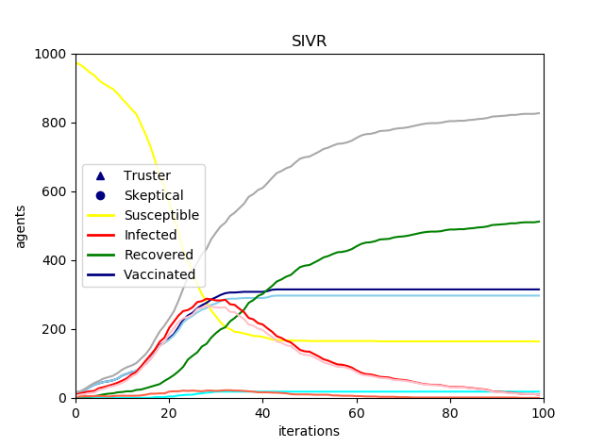
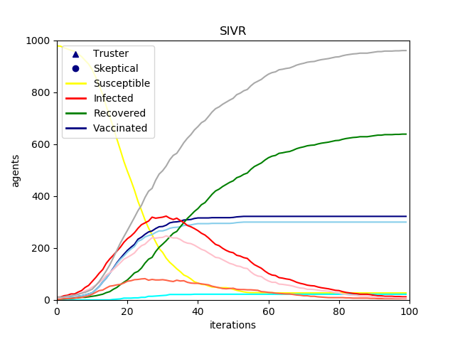
Main Results – T=2;Cvs = {0.05, 0.05, 0.1,0.1};Cvt = {0.01, 0.02, 0.01, 0.02}

Slide 16
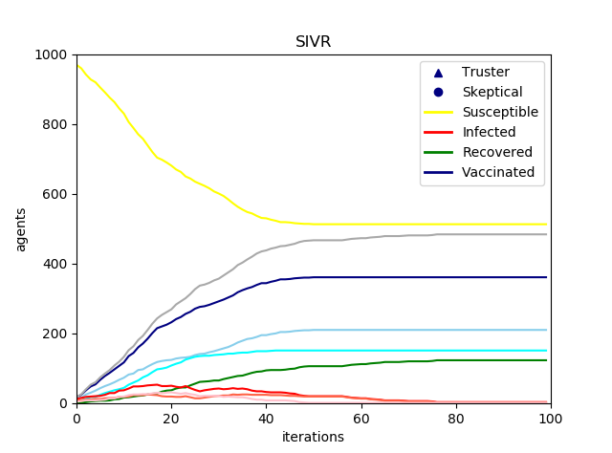
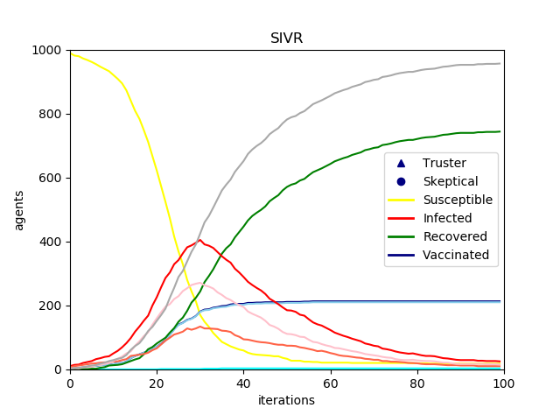
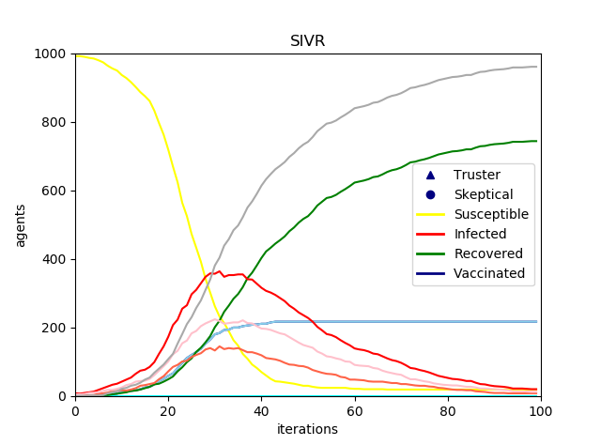
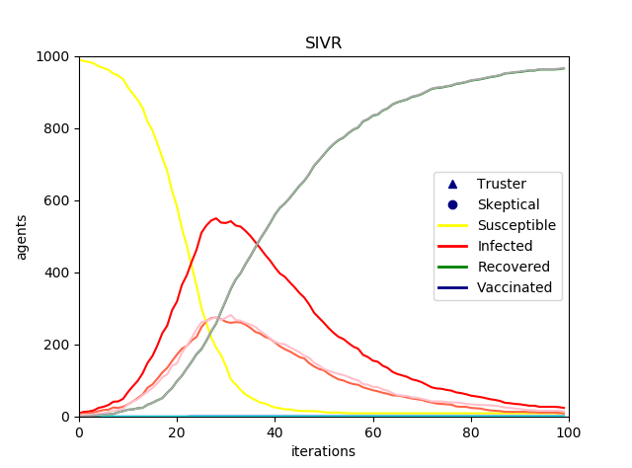
Main Results – T=5;Cvs = {0.05, 0.5, 1.0,1.0};Cvt = {0.01, 0.1, 0.1, 0.5}

Slide 17
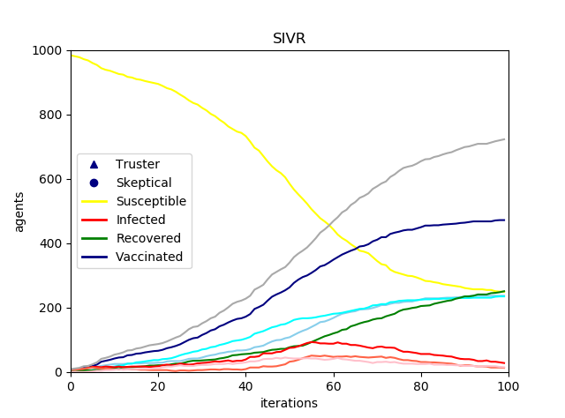
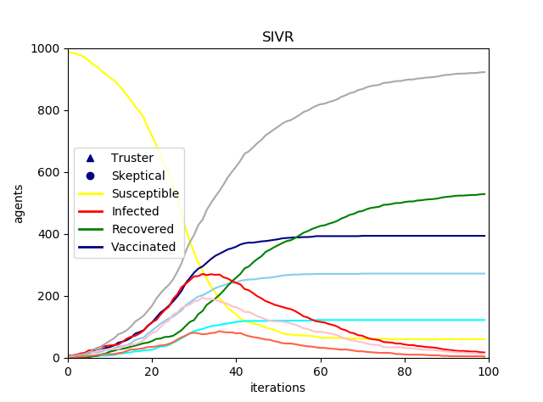
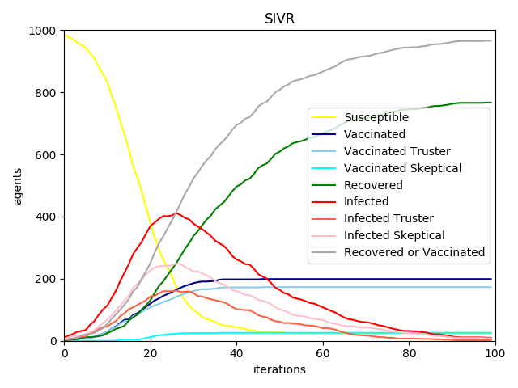
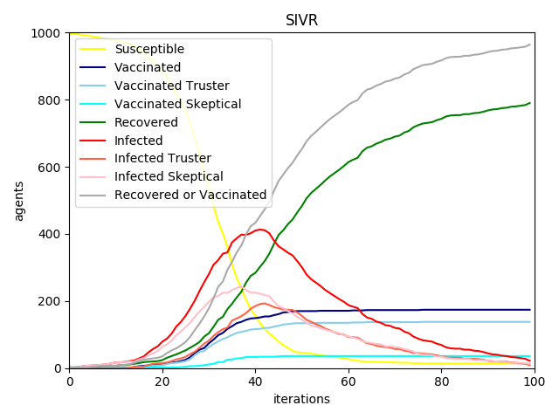
Main Results – T={10,30};Cvs = {0.05, 0.5, 0.3,3.0};Cvt = {0.01, 0.1, 0.1, 1.0}

Slide 18
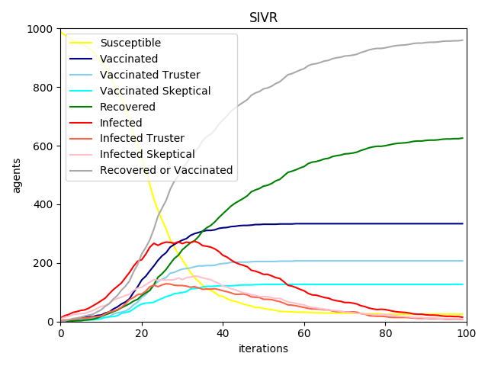
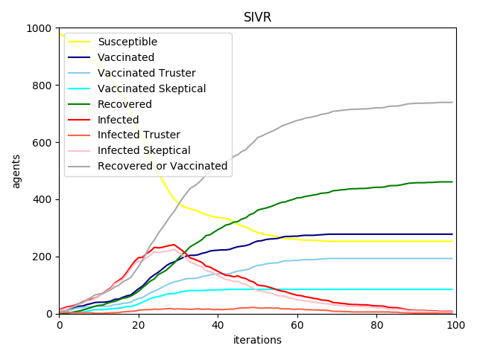
Main Results

Slide 19
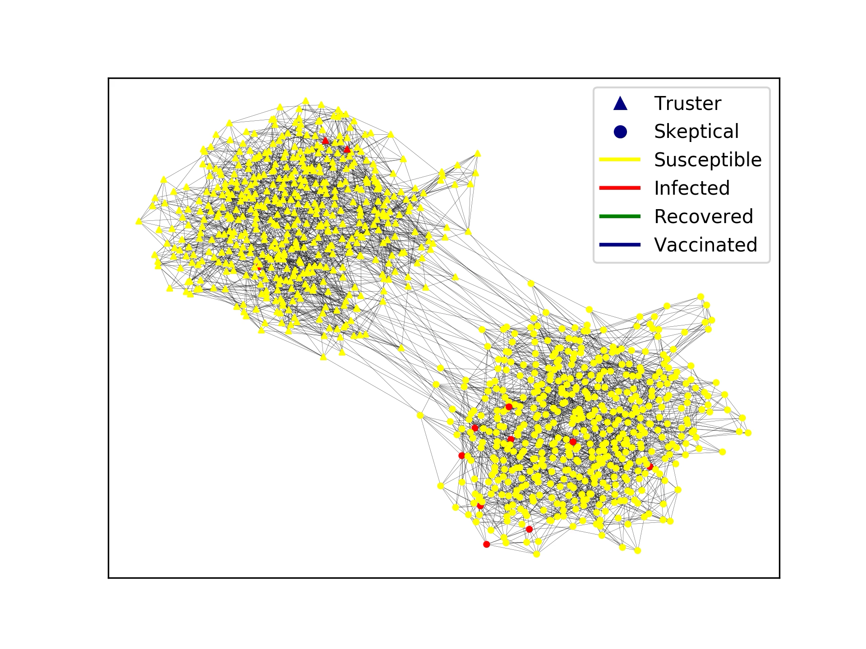
Main Results

Slide 20
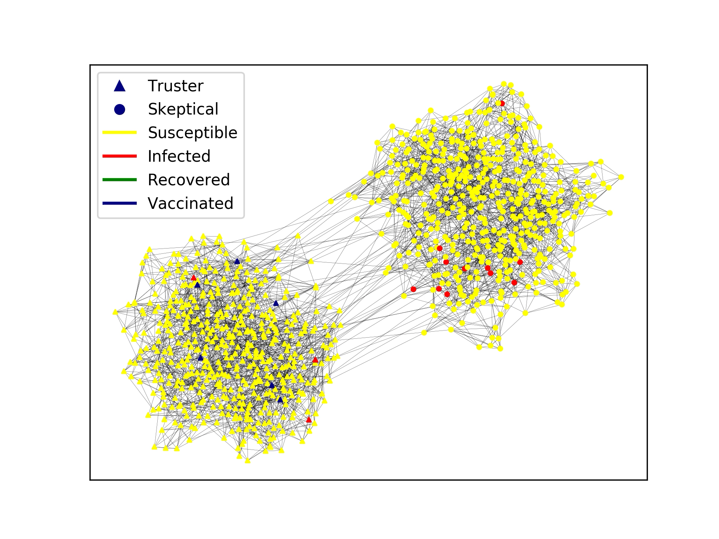
Main Results

Slide 21
Possible Extensions
Agents:
Individuals: Account for different costs and time horizons; age-structure
Non-binary coding of the groups, hence groups in-between
Allow for births and deaths in the population
Disease parameters: Infection and recovery rate, different spreads
Networks:
Different network structures, also accounting for other diseases
Dynamic networks: general demographics and accounting for agents‘ behaviours

Slide 22
Thank you very much for your attention

